Slide 1
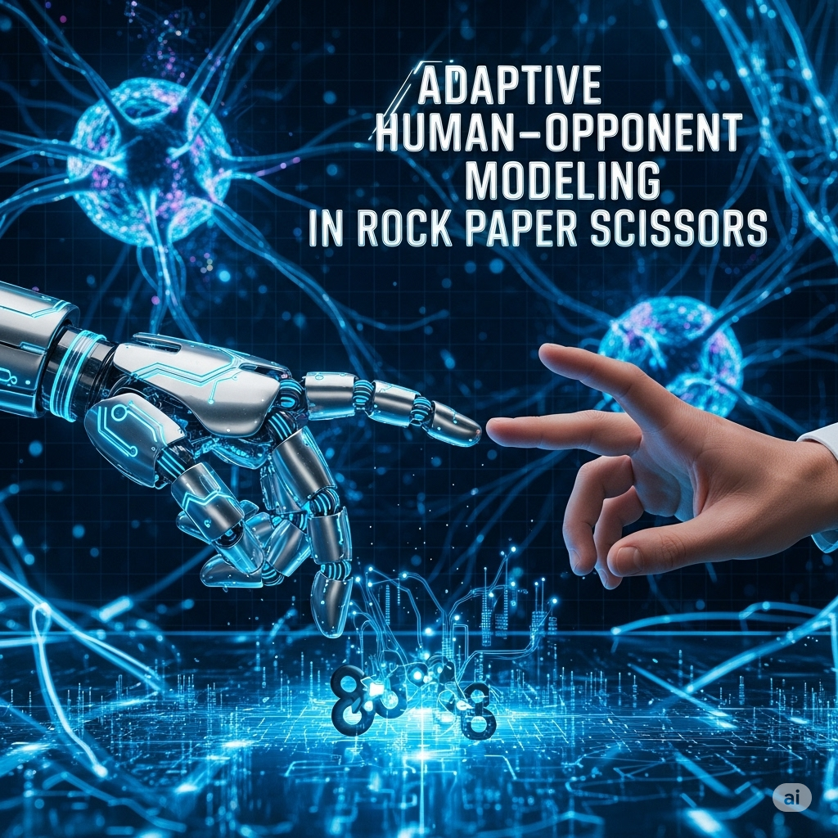

Slide 2
Abstract
With the help of real-time computer vision-based hand gesture recognition and adaptive AI strategy learning, this project provides a comprehensive Adaptive Human-Opponent Modelling system for the classic Rock, Paper, Scissors (RPS) game. Using a multi-layered opponent modelling approach and Google's MediaPipe framework for landmark detection, the system achieves real-time gesture classification and demonstrates measurable adaptation to human behavioural patterns. Using frequency analysis, sequence pattern recognition, and Markov chain modelling, the AI is more adapt at predicting opponent strategies than random play against human subjects. The fields of behavioural game theory, adaptive AI systems, and human-computer interaction are advanced by this work, which has applications in interactive gaming, psychological research, and adaptive user interfaces.
Keywords: Computer Vision, Hand Gesture Recognition, Opponent Modeling, Game Theory, Human-Computer Interaction, MediaPipe, Behavioral Analysis

Slide 3
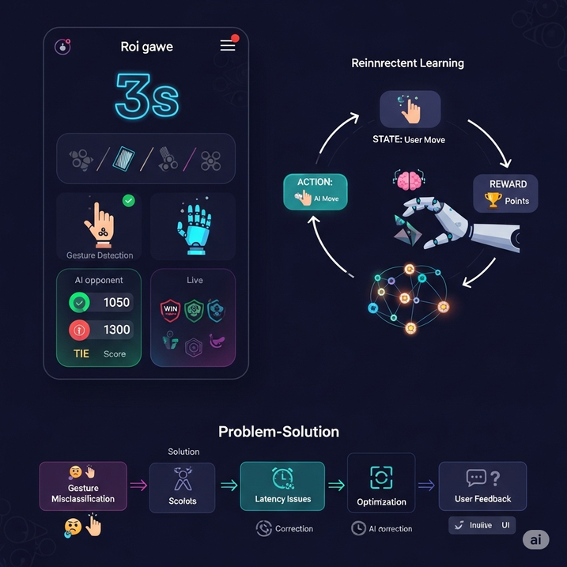
Introduction
Problem Description
Rock-Paper-Scissors (RPS) offers a rich platform for behaviour and strategy analysis despite its simple appearance. Humans rarely play randomly due to cognitive biases, which reveals patterns that can be taken advantage of. Most of today's AI adversaries can't effectively use Q learning to adapt to these behaviours.
Research Objectives
The following topics are examined in this project: Real-time gesture recognition for natural RPS communication.
identifying recurrent human patterns in RPS.
building an AI that adjusts its strategy based on human behaviour.
Additionally, a real-time graph is displayed.
System Overview
The system incorporates:
The vision module uses gesture recognition based on MediaPipe.
Game Engine: Interactive gameplay and score tracking.
AI Strategy Module: Adaptive Opponent Modelling.

Slide 4
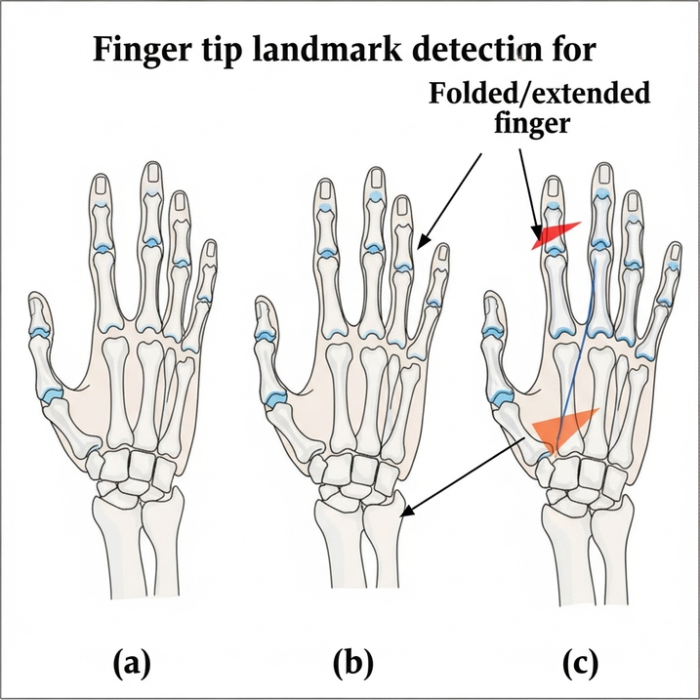
Literature Review
Gesture Recognition and Opponent Modelling
In games like poker, adaptive strategies perform better than static ones (Billings et al., 2006), and in StarCraft, online learning helps with prediction (Bard et al., 2013). Human biases such as sequential patterns are demonstrated by RPS studies (Lockett et al., 2012). Real-time tracking for gesture input is made possible by MediaPipe Hands (Zhang et al., 2020), and rule-based landmark techniques (Kumar et al., 2021) perform faster and more accurately than CNNs (Chavez et al., 2019).
Human Conduct in Video Games
According to Wang et al. (2014), humans frequently favour Rock in RPS and employ Win-Stay, Lose-Shift tactics. According to Dyson et al. (2016), analysis improves predictability over randomness.

Slide 5
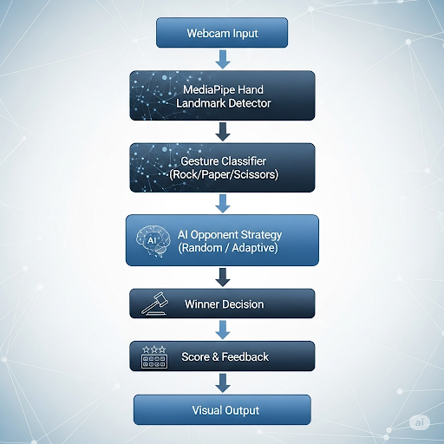
Methodology
System Flow Diagram

Slide 6
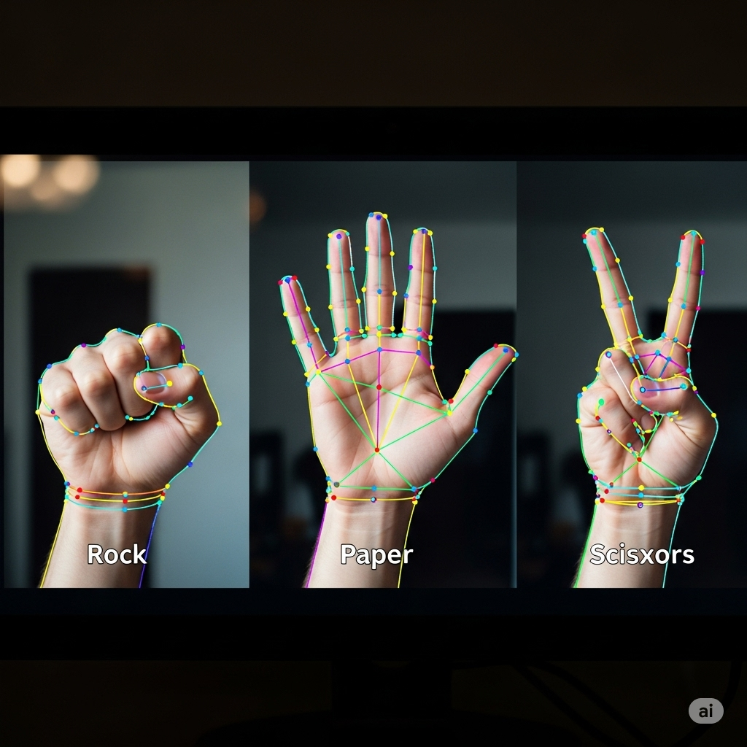
Algorithm
"The AI plays the game, learns from wins and losses, and gets smarter with experience”.
Gesture Recognition (hand_gesture_rps.py)

Slide 7
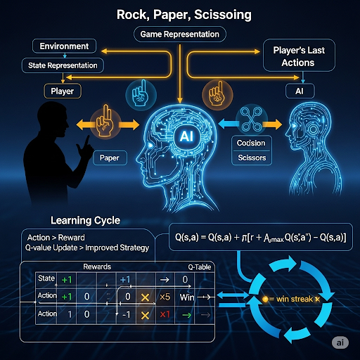
Algorithm
In Rock, Paper, Scissors in Reinforcement Learning
AI player as the game agent
Environment: Player versus AI game interface
State: Final actions of the player
AI decides between rock, paper, or scissors.
Reward: bonus for win streaks (hard mode); +1 for wins, 0 for ties, and -1 for losses.
Q-learning with Q-table is the algorithm.
Learning: Updates Q-values derived from results to enhance subsequent actions

Slide 8
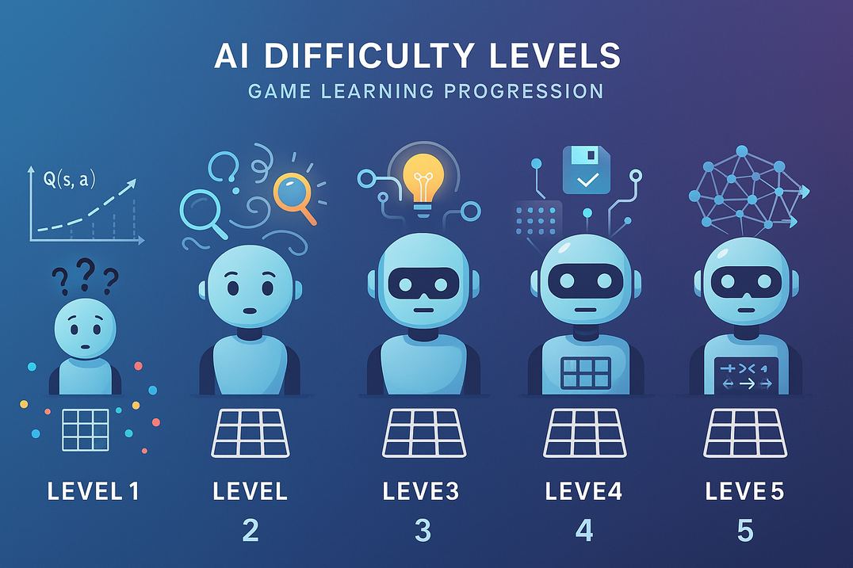
Algorithm
Levels of AI Difficulty Making use of RL
I developed five AI difficulty levels to mimic learning progression:
Level 1: Unplanned actions (no learning)
Level 2: Q-learning AI that is highly exploratory (inquisitive)
Level 3: Moderate exploration and Q-learning
Level 4: Persistent memory Q-learning (Q-table loaded/stored)
Level 5: Advanced Q-learning using reward shaping and opponent pattern prediction (Markov-style memory)
This scaling demonstrates the AI's transformation from a random learner to a strategic learner that adjusts to the player.

Slide 9
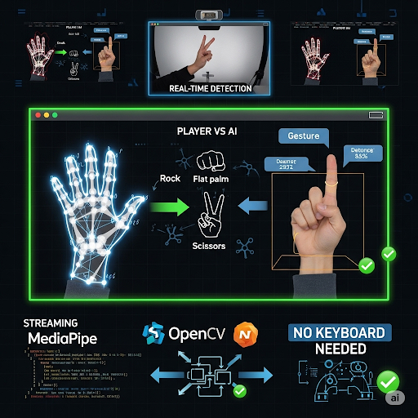
Algorithm
Gesture Recognition
MediaPipe and OpenCV are used to identify Rock, Paper, Scissors hand gestures in real time using webcam input in order to add more interaction to the game.
Players can now use hand signals in place of keyboard input thanks to this.

Slide 10
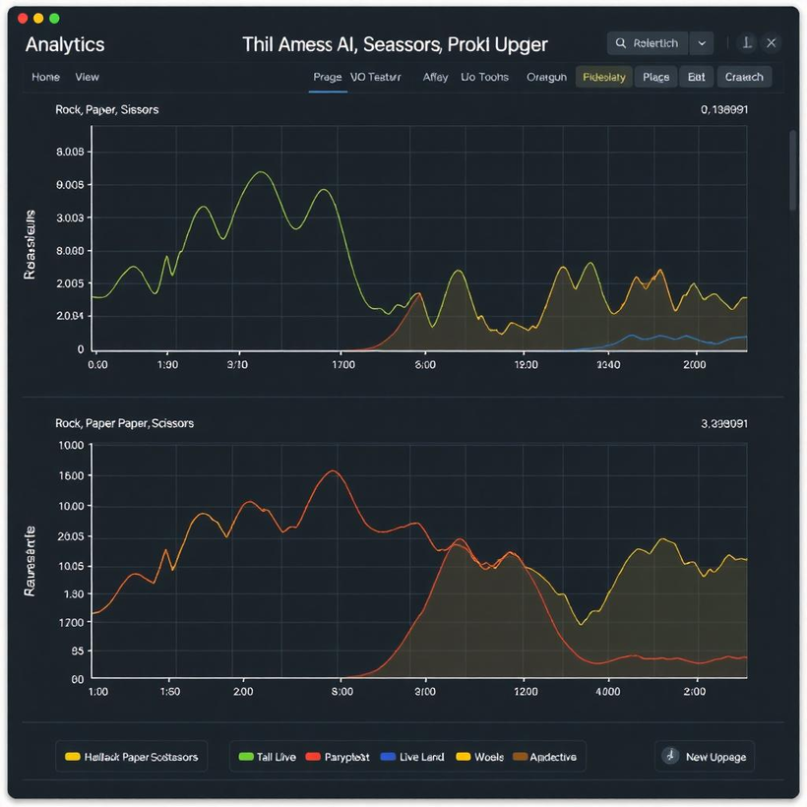
Algorithm
Real Time Performance Graph
Matplotlib is used to add a real-time graph that shows how the AI gets better over time.
It displays:
Accuracy: the frequency with which the AI accurately forecasts the user's next action
Win Rate: the proportion of rounds that the AI wins
These metrics show the agent's real-time learning progress.

Slide 11

Contributions & Learning Outcomes
Key Contributions
Designed a real-time gesture interface for human-computer interaction.
Implemented gesture classification using landmark-based rule logic.
Built an interactive RPS game with dynamic score and UI.
Laid foundation for behavior-aware AI agents in competitive settings.
Learning Outcomes
Hands-on experience with MediaPipe, OpenCV, and Tkinter GUI.
Practical application of AI opponent modeling and game theory.
Understanding of human behavioral patterns in decision-making.
Integration of computer vision and AI strategy in real-world interaction systems.
Gadha Suresh(CB.PS.I5DAS22018) -
Designed and implemented the coding modules.
Developed the training, testing, and integration of AI with real-time graphing.
Ensured persistence (Q-table storage) and adaptive opponent modeling
Sandra K S(CB.PS.I5DAS22049)-
Conducted literature research on gesture recognition, opponent modeling, and game theory.
Designed and prepared the presentation (PPT) structure and content.
Supported documentation and theoretical framing of the project.

Slide 12
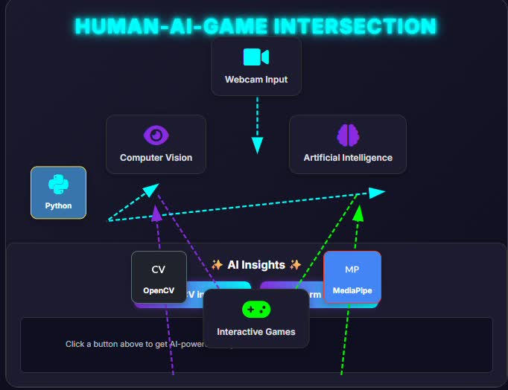

Slide 13

REVIEW - 2

Slide 14
Overview
The objective is to develop an adaptive RPS AI that takes advantage of human behavioural biases by utilising opponent modelling and real-time hand gesture recognition.
Tech stack: Tkinter + MediaPipe + OpenCV for gesture recognition; Q-learning with Q-table for AI strategy.
Five levels of difficulty are available for AI, ranging from random play to sophisticated Q-learning with persistent memory and Markov-style pattern prediction.
Opponent Modelling: Predicts human movements (e.g., Win-Stay Lose-Shift, Rock bias) using Markov chains, frequency analysis, and sequence patterns.
Key features include gesture input via a webcam in real time, eliminating the need for a keyboard.
Real-time tracking of win-rate and accuracy.
Contributions: Creates interactive, human-aware systems by combining adaptive AI, behavioural game theory, and computer vision.

Slide 15
Improvements
Feature | First Version | Final Version | Relevance
Visualization | Matplotlib popup window | Embedded OpenCV graph (Win Rate, Q-States, Avg Q) | Professional, crash-free demo
Error Handling | Minimal | Camera check, Q-table load/save errors, Tkinter cleanup" | Robust for demos

Slide 16
Research-Inspired Implementation of Opponent Modeling in Multi-Agent Reinforcement Learning
Rock-Paper-Scissors reinforcement learning project skilfully combines concepts from "Opponent Modelling in Poker" and "Modelling Opponent Learning in Repeated Games". We took the idea of agents that model their opponents’ evolving strategies over repeated interactions from the first paper. The use of Q-learning with history-based state representation demonstrates this, as the AI gradually picks up on and adjusts to the user's actions. Similar to how agents in the paper refine their strategy towards stable equilibria, progressive opponent learning is further simulated by using adaptive difficulty levels and a ε-greedy exploration policy.
Since the AI must interpret imperfect visual information (hand gestures detected through Mediapipe) rather than having direct knowledge of the player's move, we took the concept of adaptive decision-making under uncertainty from the poker research. Similar to how a poker AI modifies its model in response to observed betting behaviour, our system continuously updates Q-values in real time. Long-term learning persistence is also ensured by the ability to save and reload the learnt Q-table, which enables the AI to accumulate experience across sessions. This feature closely resembles the adaptive memory mechanism used in poker opponent modelling.

Slide 17
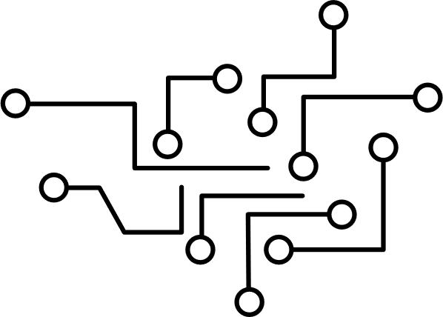
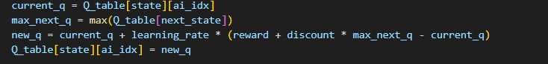
Algorithm
1. Q-Learning (Model-Free Reinforcement Learning)
What it does: Learns an optimal policy by updating action-value estimates (Q-values) based on rewards.Why used: To enable the AI to learn from wins/losses and adapt its strategy over time without knowing game rules in advance.

Slide 18
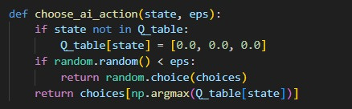
Algorithm
2. ε-Greedy Policy (Exploration vs Exploitation)
What it does: Balances trying new actions (exploration) vs using the best-known action (exploitation).
Why used: Prevents the AI from getting stuck in suboptimal strategies. At Level 5, eps=0.05 → 95% exploitation, 5% exploration.

Slide 19
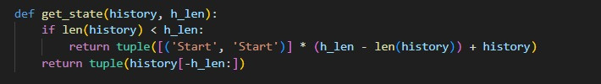
Algorithm
3. Markov State Representation (Approximate MDP)
What it does: Converts the history of moves into a "state" so RPS can be treated as a Markov Decision Process.

Slide 20

Contribution
Gadha Suresh (CB.PS.I5DAS22018)
Q-learning core was implemented using adaptive ε-greedy policy and Markovian state representation.
Created an AI adversary model that uses Q-table storage to persistently learn human patterns.
Created a live performance graph with real-time metrics (Win Rate, Q-States, and Avg Q).
Level-progression logic was designed to guarantee that learning was validated before progressing.
Sandra K S (CB.PS.I5DAS22049)
Investigated RL, opponent modelling, and gesture recognition in human–AI interaction.
MediaPipe was used to build a pipeline for hand gesture detection and stabilisation.
Created a real-time user interface using learning graphs, score tracking, and OpenCV visuals.
Oversaw the creation of presentations, documentation, and the ethical justification of adaptive AI.

Slide 21
Conclusion
Builds a human-interactive, adaptive AI system by fusing computer vision and reinforcement learning.
Interprets human input and permits natural interaction through the use of real-time gesture recognition.
Combines adaptive decision-making, Q-learning, and opponent modelling to provide intelligent gameplay.
Continuously learns and gets better through real-time interactions with other users.
Shows independent behavioural adaptation based on human tactics that have been observed.
Incorporates performance metrics to track and display learning progress over time.
Converts theoretical research into a workable, practical application (e.g., opponent modelling in repeated games).
Draws attention to the potential of adaptive AI in intelligent user interfaces, human-AI collaboration, and interactive gaming.

Slide 22

References
1.Billings, D., Burch, N., Davidson, A., Holte, R., Schaeffer, J. (2006). Opponent Modeling in Poker.
2.Modeling opponent learning in multiagent repeated games
(https://dl.acm.org/doi/10.1007/s10489-022-04249-x)
3.MediaPipe Documentation- (/ai.google.dev/edge/mediapipe/solutions/guide)
4.Hanshu Zhang,Cleotilde Gonzalez,Frederic Moisan(2020).Paper-Rock-Scissors: an exploration of the dynamics of players’ strategies
5.OpenCV and Tkinter Documentation

